Slide 1
Welcome! We are glad you are here

Slide 2
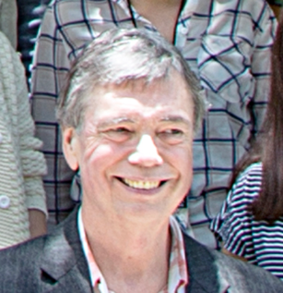
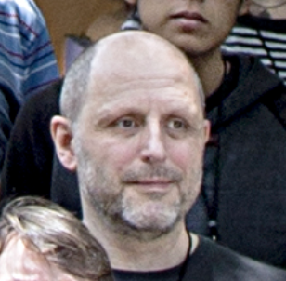
Cloudy Classic
Gary Ferland U Ky
Peter van Hoof ROB

Slide 3
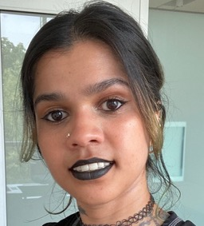
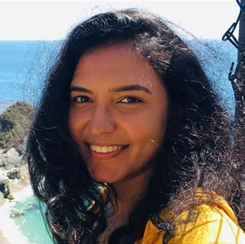
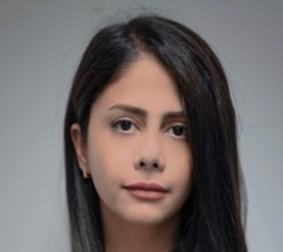
Cloudy, the next generation
Chamani Gunasekera STScI
Priyanka Chakraborty CfA
Gargi Shaw TIFR
Maryam Dehghanian, Vir Tech

Slide 4
Group projects
Break up into small (~6 people) groups of like-minded participants
Define a research problem you will do using Cloudy
The project/group must have a memorable name (needed to get grants or telescope time)
Give brief presentations of the projects at the end of each day
(See projects from old workshops)

Slide 5
Cloudy on the web
Project wiki, GitLab repository
project www.nublado.org
User forum – a place to ask questions
https://cloudyastrophysics.groups.io/g/Main/topics
Cloudy workshops
https://cloud9.pa.uky.edu/
Cloudy release papers
2023RMxAA..59..327C 2023RNAAS...7..246G
2017RMxAA..53..385F
2013RMxAA..49..137F
1998PASP..110..761F

