Slide 1
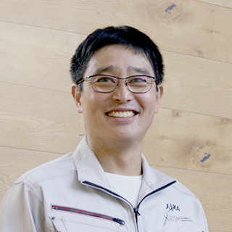
Masahiro Tsujimoto (JAXA ISAS)
Contact: tsujimot@astro.isas.jaxa.jp
Web page: https://www.isas.jaxa.jp/home/tsujimot
Contact
Instrumentation for space-borne observatories.
--- all aspects of mission life cycle (concept, design, I&T, launch, operation, and calibration).
Chandra for X-ray CCD (2003-08)
Suzaku for X-ray CCD (2005-15).
ASTRO-H for X-ray µ-calorimeter spectrometer (2008–17).
XRISM for X-ray µ-calorimeter spectrometer (2017–24).
LiteBIRD for submm bolometer (2017–).
High-energy astrophysics w. X-ray & multi-λ obs. Recent topics are:
Revealing the nature of γ Cas analogs.
Investigation of non-equilibrium ionization in stellar flares.
X-ray Doppler tomography of high-mass X-ray binaries.
Radiative transfer modeling of accretion disk corona sources.
Hard X-ray phenomena of classical novae.
Thesis advisor for grad students.
Research interests
Endpoints of stellar evolution, PNe, SNRs, X-ray, UV, Opt, IR, radio:
--- X-ray spectra from accretion disk corona sources.
Choice of group work topic

